Slide 1
Jarvis Home Assistant
Team Protégé
Anish Chopra, Jason Milasincic, John Weber, Gregory Desrosiers

Slide 2
Jarvis Home Assistant
Idea
Complete and Integrated Home Automation
Eliminate repetitive and sequential tasks
Extend functionality of Google Home
Have someone ‘at-home’ even when you’re not
Learning Objectives
Integration of software systems and cloud architectures
Tap into the Internet of Things
Explore the topic of Home Automation

Slide 3
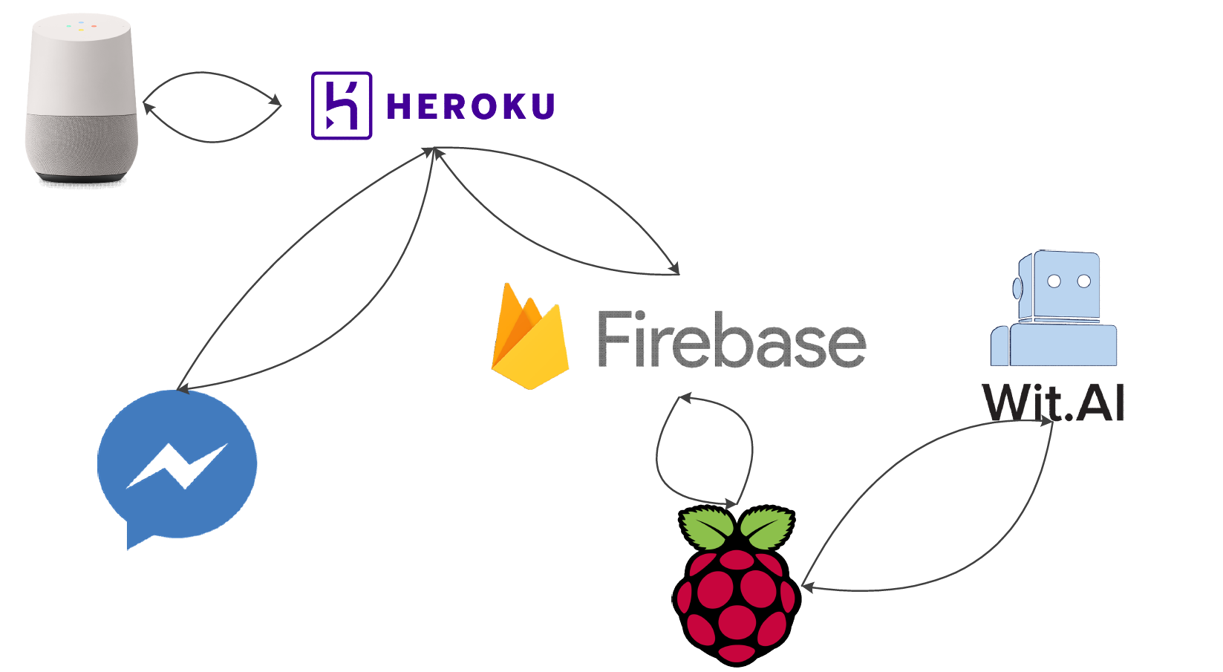
Workflow

Slide 4
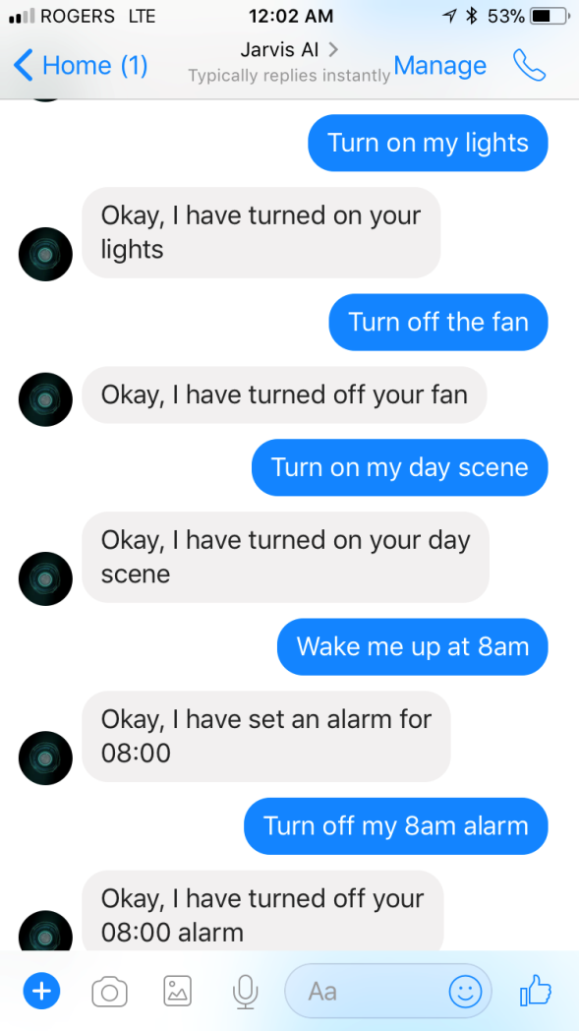
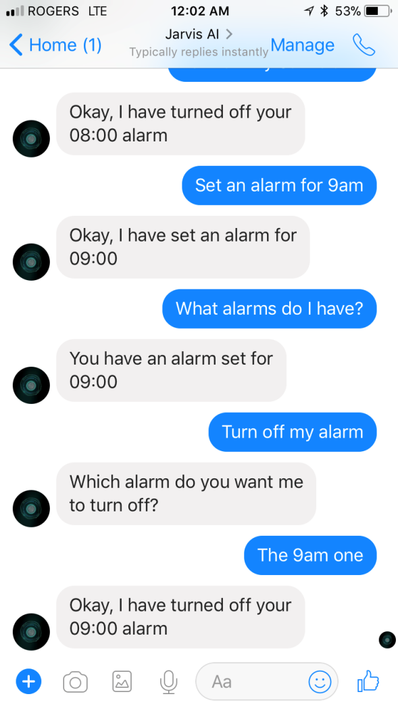
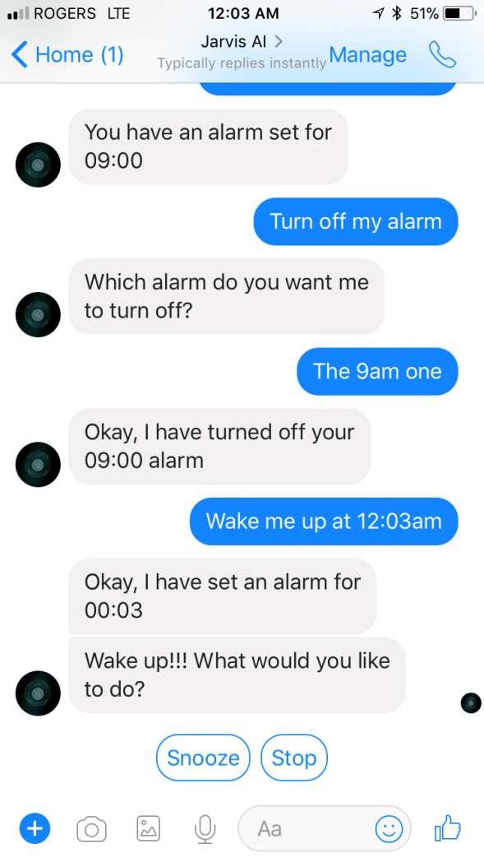
Facebook Messenger Integration

Slide 5
Challenges
Deciding on platforms to build on
Google Assistant and Google Home
Raspberry Pi
Subsequently integrating these platforms
Integrating ‘things’ into Jarvis
No standard API

